Slide 1
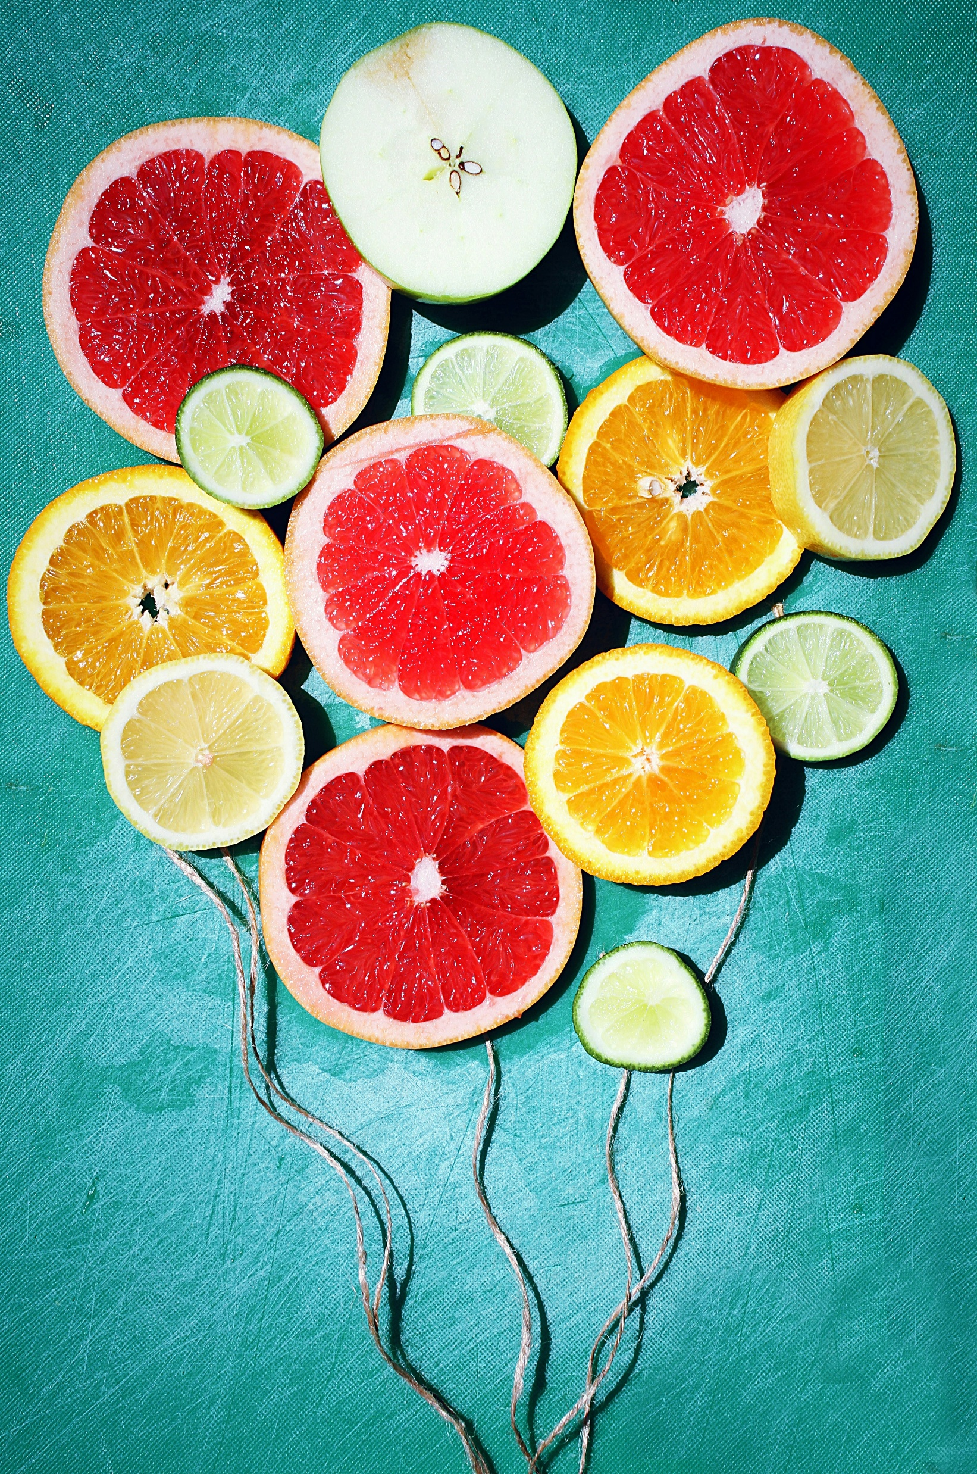
Hereditary Fructose Intolerance (Fructosemia) – Case
Linn Helene Stølen
Adult metabolic dietitian
Oslo University Hospital
NIEM Stockholm 2025
Foto: Toa Heftiba, Unsplash
Notes:
I work with dr Kiarash Tazmini, who is an endocrionologist

Slide 2
Not to be confused with fructose malabsorption
Notes:
Hereditary fructose intolerance is not to be confused with fructose malabsorption
Belongs to the IBS or irritable bowel syndrom world
But I’ve seen sometimes fructose malabsorption is wrongly called fructose intolerance

Slide 3
«Individuals with hereditary fructose intolerance (HFI) are perfectly healthy as long as they do not ingest food containing fructose, sucrose and/or sorbitol.»
Saudubray 2022

Slide 4
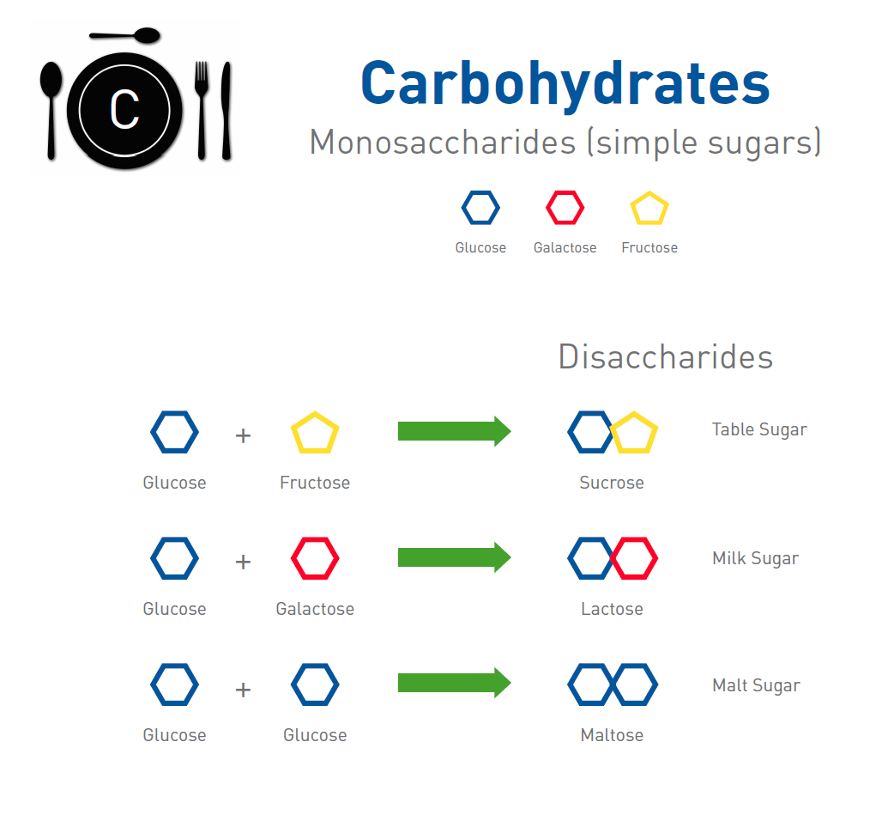
Metabolic Teaching Aid, Laurie Bernstein
Notes:
Of simple sugars we have glucose, galactose and fructose.
Glucose + fructose gives sucrose
…

Slide 5
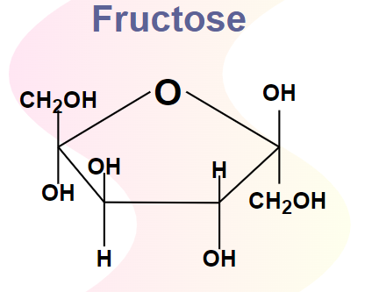
Hereditary Fructose Intolerance
Reaction to fructose described in 1956
Enzyme deficiency described 4-5 years later
Strong aversion to sweet foods from an early age
3-5 children per 100 000 are born with HFI in Europe every year?
Foto: Geeksforgeeks.org
Notes:
Patients develop strong aversion to sweet foods from an early age
According to information from the Sweedish Socialstyrelsen, 3-5 children per 100 000 are born with hereditary fructose intolerance in Europe every year
Which means there should be 300-500 persons in Sweden with the diagnosis, and there should be born 2-3 children with the diagnosis in Norway each year.
I think in total we follow and know of 6 patients with HFI in Norway, adults and children, one adult is from Spain

Slide 6
Hereditary Fructose Intolerance
Symptoms:
Nausea, vomiting, abdominal pain, hypoglycemia and elevated liver enzymes after dietary fructose exposure
Chronic exposure: failure to thrive, liver failure, renal failure, eventually death
Kim et al., Gut Liver 2021

Slide 7
Hereditary Fructose Intolerance
Usually manifests in infants when they are being weaned off breastmilk
Some patients remain undiagnosed due to the voluntary avoidance of sweet foods.
Examples from case reports:
41 y old Korean woman who complained of sweating, nausea, and vomiting after consuming sweets
50 y old German woman with a life long history of aversion to sugary foods
Kim et al., Gut Liver 2021
Yasawy et al., World J Gastroenterol. 2009
Notes:
Usually manifests in…
Because HFI has an excellent prognosis when patients maintain a strict restrictive diet, some patients …
The article I’m referring to here describes a 41 y old…
… and she was diagnosed with hereditary fructose intolerance
50 y old… She also described nausea, vomiting, diffuse abdominal pain and hypoglycemic symptoms even after the smallest amount of sugar or fruit.

Slide 8
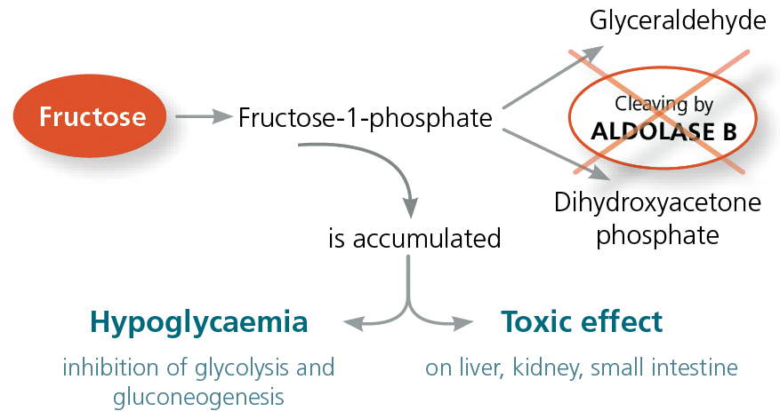
Hereditary Fructose Intolerance
https://www.imd-berlin.de/en/subject-information/diagnostics-information/hereditary-fructose-intolerance-hfi
Notes:
The disorder is caused by a deficiency in aldolase B, the second enzyme of the fructose pathway
Aldolase B splits fructose-1-phosphate (F-1-P) into dihydroxyacetone phosphate and glyceraldehyde
F-1-P accumulates, and…

Slide 9
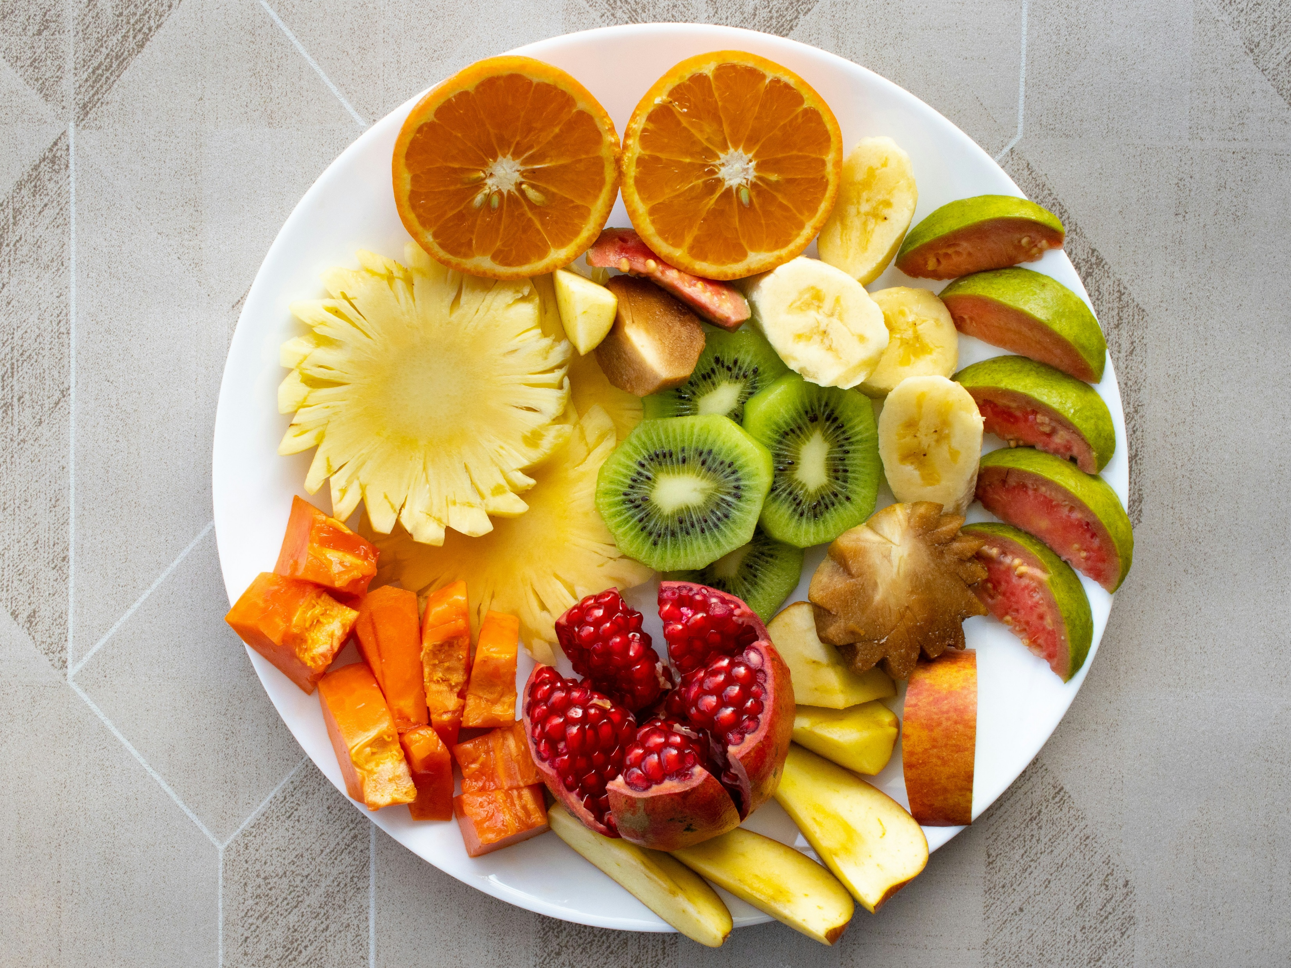
Treatment
Avoidance of fructose, sucrose and sorbitol
< 40 mg fructos/kg body weight
Intake up to 2,5 g of sucrose daily (1,25 g fructose) without symptoms
In adulthood, limited fructose intake (<6 g daily) is tolerated (= < 12 g sucrose)
The optimal level of restriction is yet to be decided
Varying individual sensitivity to fructose
Saudubray 2022, Úbeda et al, Diseases 2024
Foto: VD Photography, Unsplash

Slide 10
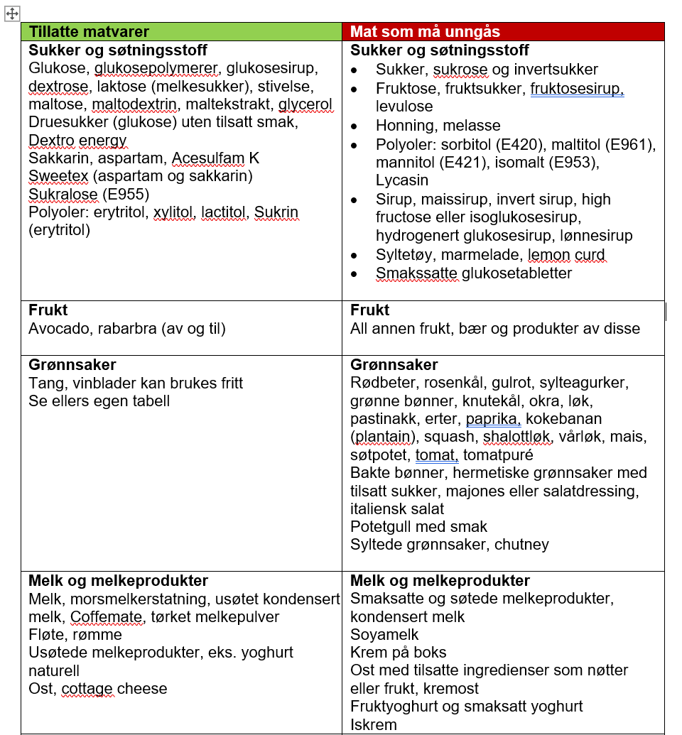
Notes:
Seaweed and grape leaves

Slide 11
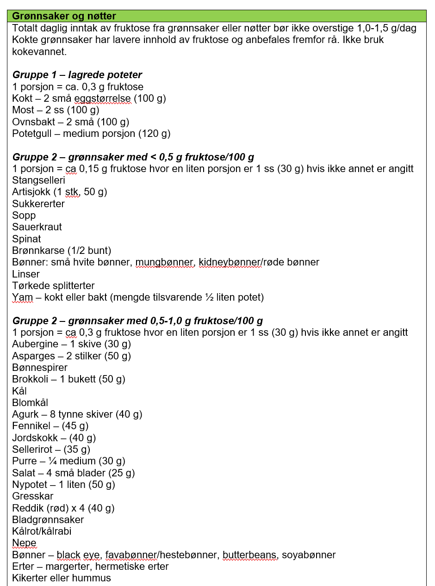
Notes:
2 egg sized potatoes
1 TS of some vegetables

Slide 12
Case
69 y old woman
Referred with the question of hereditary fructose intolerance
Bipolar disorder
Recently treated for breast cancer – afraid of hospitalisation and getting food or medications with fructose, sucrose or sorbitol
Didn’t have confirmed HFI diagnosis, she is self taught about the diet
Notes:
Our patient is a 69 y old woman, born 2 y before reaction to fructose was described and 6-7 y before the enzyme deficiency was described
Referred to us 2,5 years ago
I don’t remember how she found out about the diagnosis
Consultation with a dietitan at her local hospital, recommended referral to our adult metabolic unit at Oslo University Hospital

Slide 13
Case
Low weight at 10 months, vomiting
Hospitalised, vomited all foods
1 y old: 6 kg
Organs didn’t work
Abnormal blood tests
Notes:
As a child…

Slide 14
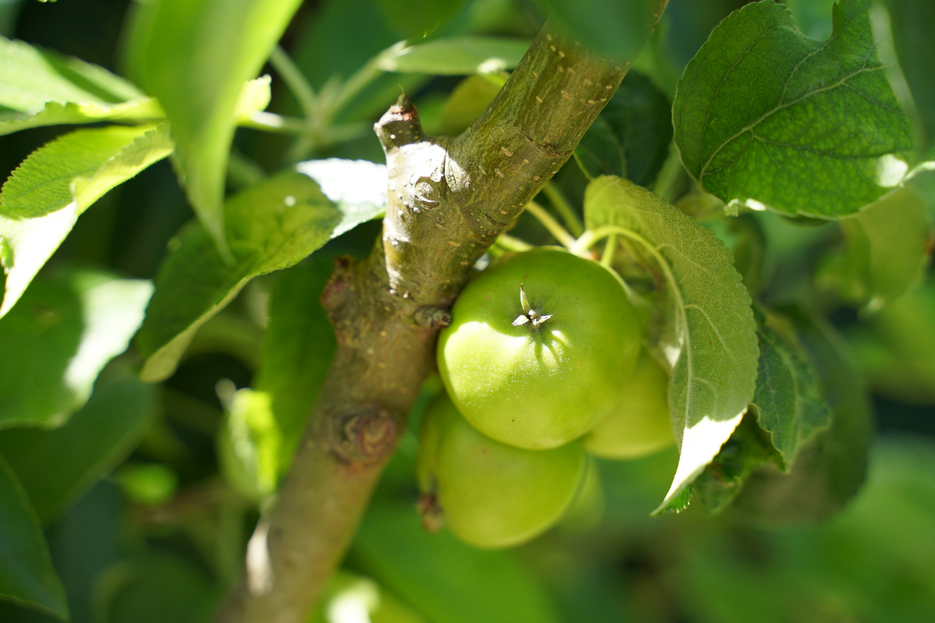
Case
Avoided all fruits, vegetables and sweet foods since she was little.
May eat unripe gooseberries, apples, blueberries, grapes or lemon on rare occations
Strong aversion against sugar and sweet foods
Foto: Sebbi Strauch, Unsplash
Notes:
Was allowed to eat what she wanted. Was not pressured to eat anything.

Slide 15
Case
No episodes of nausea or vomiting after ingestion of food since she was hospitalised as 1 y old
Loose stools if ingesting foods with some sugar, like too much mackerel in tomato sauce or 85 % dark chocolate
Feels her blood «boiling» if she ingests fructose
Inflamed gums before she started making her own homemade tooth paste
Mostly keeps a strict diet
Notes:
Feels her blood boiling if she ingrests fructose,
Inflamed gums…
but it’s a bit hard for her to describe her reaction to ingestion of fructose, sucrose or sorbitol and some of the symptoms seems a bit strange and not described for this diagnosis

Slide 16

Case
Genetic testing confirms hereditary fructose intolerance
Foto: Sebbi Strauch, Unsplash
Notes:
No other indications than strong aversion to fruits, vegetables and sweet foods, and a history of hospitalisation with vomiting, organ malfunction and abnormal blood tests as a child

Slide 17
Medical journal 1955
Breastfed until 6 mo., then mixture with cow’s milk because mother had mastitis
From 3 mo.: Cod liver oil and orange juice as a supplement
From 7 mo.: Rusk porridge with apple or banana and som mashed potatoes
At 10,5 mo. (upon admission to Rikshospitalet): 1 L of cow’s milk daily, banana or apple, some semolina porridge with malt extract, rusk porridge and some vegetables. Cod liver oil, Sanasol (liquid vitamins) and iron. Frequent vomiting.
Notes:
At 10,5 mo old, upon admission to Rikshospitalet, her diet consisted of

Slide 18
Medical journal 1955
Reportedly thrived well, had normal development and growth the first 8 months.
Two episodes of fever and vomiting at 8-9 mo. old, then relatively well, but vomiting once a week
Eats poorly. Tummy ache after having eaten just a little. Gets whiny and turns away from the food, eats a little more after 5 min. Vomits if she’s given milk that’s older than one day. Vomits when she’s given potato.
Poor weight gain, has become thinner
Notes:
the mother has the impression that she gets a tummy ache after having eaten just a little,
vomits when she’s given potato according to mother

Slide 19
Medical journal 1955
13 mo. old: check up at the hospital after 3 weeks at home. Has been healthy, happy, thriving and eats well. No vomiting.
Breakfast: Semolina porridge with rosehip powder
Lunch: Vegetables, fish balls, meat balls
Afternoon: rusk porridge with banana or bread
Evening: bread
Drinks milk
Notes:
At this time they didn’t know about the diagnosis at the hospital, so after some time she was sent home

Slide 20
At home
Mother let her eat what she wanted and could tolerate
Developed an intuitive way of eating
Has kept her healthy

Slide 21
Current diet: taste is the measure, and the body decides

Slide 22
Goes after taste – tastes everything, but cannot eat too much sweet food over time
Avoids fruits, vegetables and sweet foods
Eats seasonally based, important that foods are fresh
Cannot have stored vegetables, tolerates them more when they are fresh
Fresh meat and fish
Thinks she can «neutralize» some sugar by eating 200 g of cheese
Lets her body decide what’s good for her to eat
Notes:
That’s logical because stored vegetables develop more sugar
Can have unripe tomatoes and the other unripe fruits and berries I mentioned earlier
Eats potatoes from June until March, but not in April and May.
Broccoli 5 times a year, tolerates best summer and fall
Can have the white on lemons and lemon juice the first 10 days after they arrive in the store
She says she need to have fresh meat and fish, if they’re not fresh, she can taste it, it needs to be well within the best before date
I say to her that meat and fish doen’t have carbs, so her reaction to less fresh meat and fish must be something else than her fructosemia

Slide 23
Diet as an adult
Supplement: B-vitamins
1,5 L of milk with vitamin D (covers calcium, iodine and vit D)
Very low intake of vitamin C – skeptical of supplements, eventually takes it, but then stops
No measure of blood vitamin C without supplement. Apparently no symptoms without supplements. Will measure vitamin C without supplements next time.
Notes:
She feels she has some kind of reaction to vitamin C after taking it for a while

Slide 24
Take home message
Patients are perfectly healthy as long as they do not ingest food containing fructose, sucrose and/or sorbitol
Develop strong aversion to sweet foods from an early age
Dietary history can be revealing
Varying individual sensitivity to fructose
How many undiagnosed patients?

